Slide 1

Have you ever heard of a ‘giant’?

Slide 2

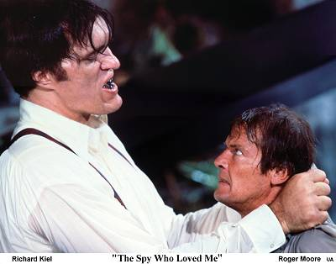
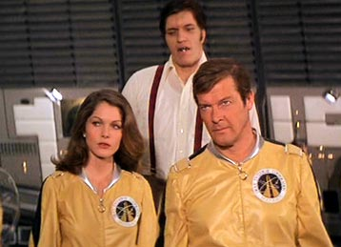
“Moonraker”

Slide 3
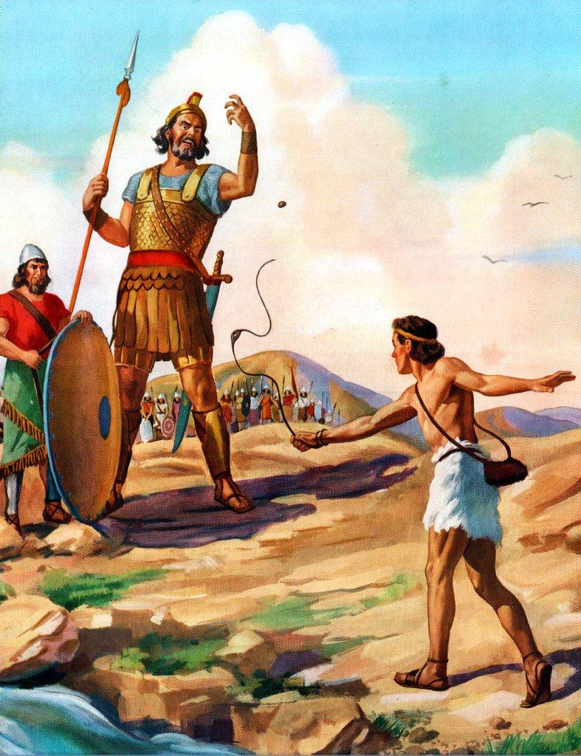
David and Goliath
Notes:
http://www.medicaldaily.com/malcolm-gladwells-david-and-goliath-experts-criticize-scientific-basis-his-dyslexia-argument-261257
All these are just guess work
But lets turn to real giants

Slide 4
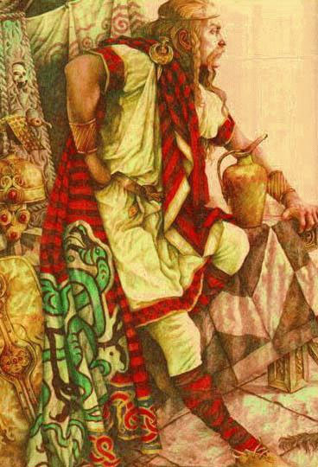
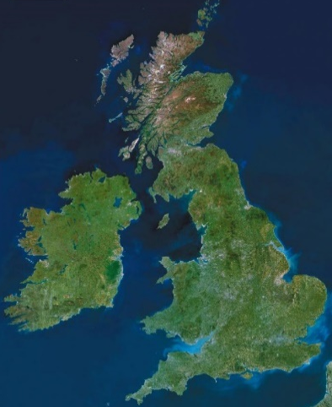
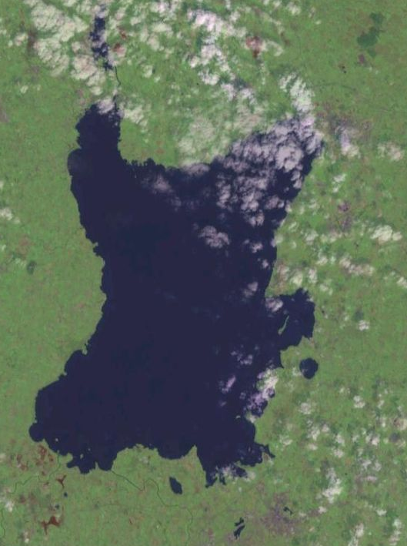
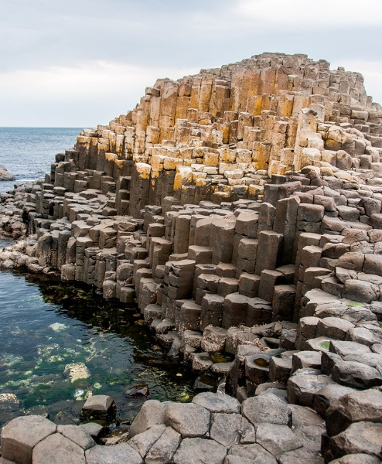
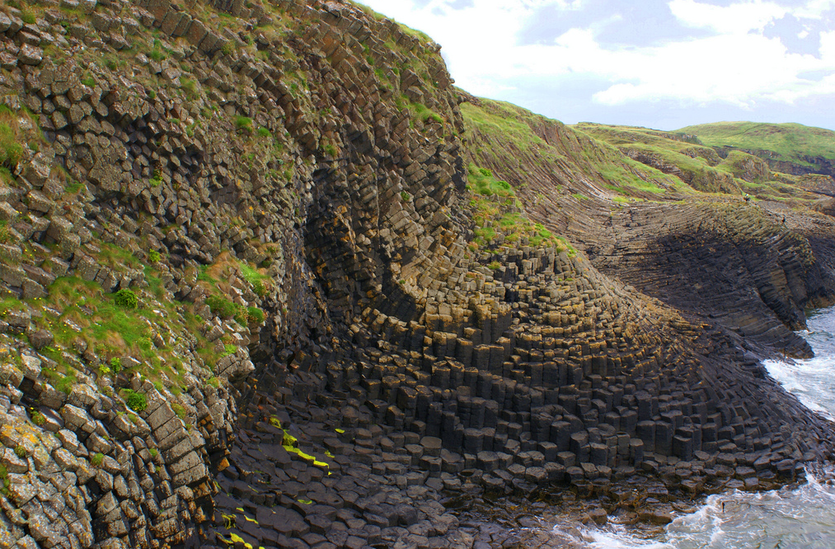
Irish legend "Finn MacCool"
Popular folklore
Legend has it that he built the Giant's Causeway as stepping-stones to Scotland, so as not to get his feet wet
He also once scooped up part of Ireland to fling it at his Scottish rival, but it missed and landed in the Irish Sea — the clump became the Isle of Man and the void became Lough Neagh
Lough Neagh
Giants Causeway, Northern Ireland
Scotland,
Staffa island

Slide 5
To be a ‘giant’
Excess growth hormone
Open epiphysis
  Child
  Delayed puberty
    Tumour destroys LH&FSH cells
    High prolactin inhibits puberty
Notes:
To be an acromegalic giant, as we wlll see later that giant could be not just for GH secreting tumours

Slide 6
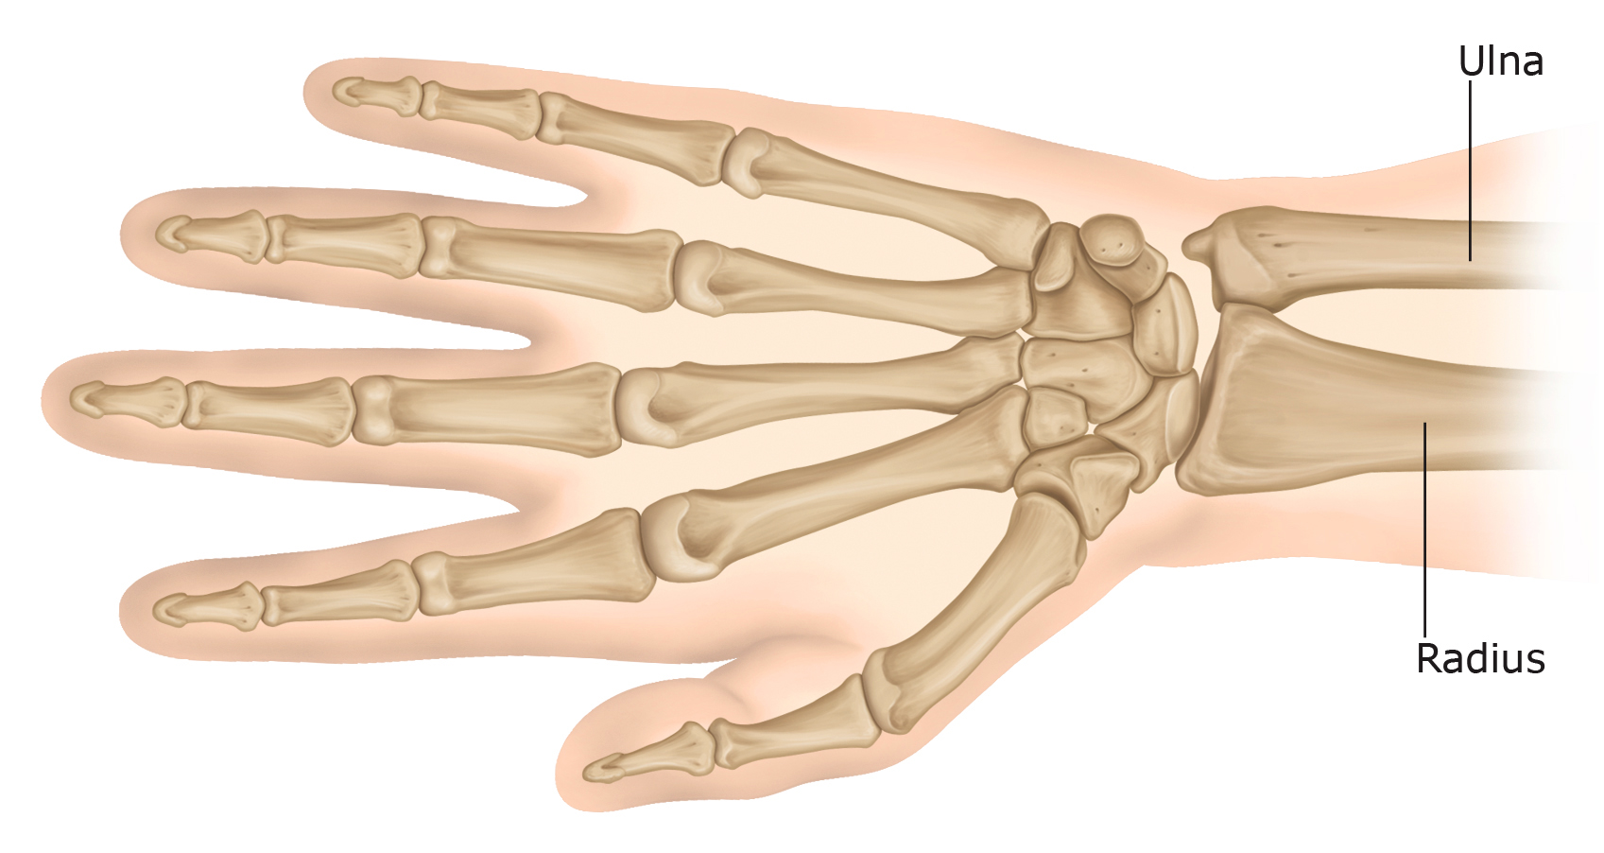
Bones of the wrist

Slide 7
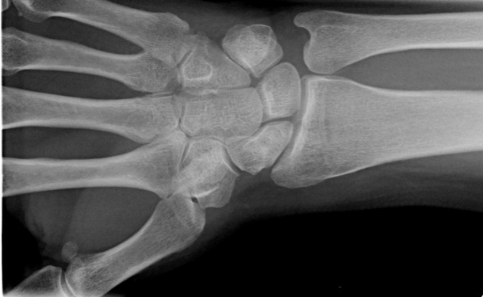
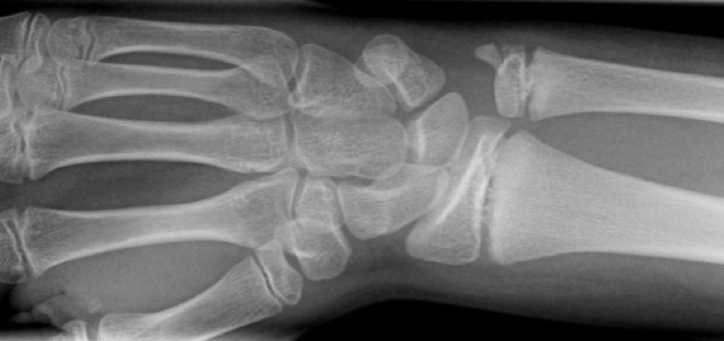
Adult
Child
Notes:
http://www.imageinterpretation.co.uk/wrist.html

Slide 8
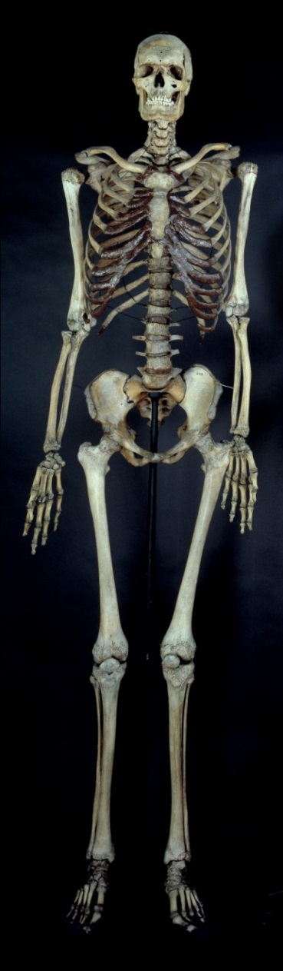
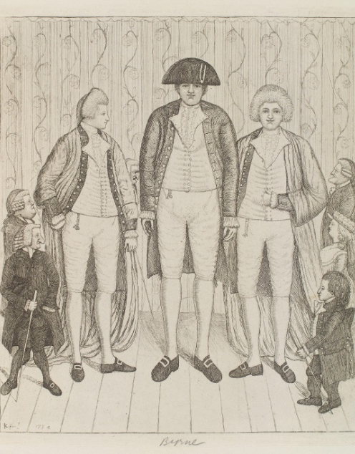
Charles Byrne (1761-1783)
Hunterian Museum London
231cm
Notes:
8

Slide 9
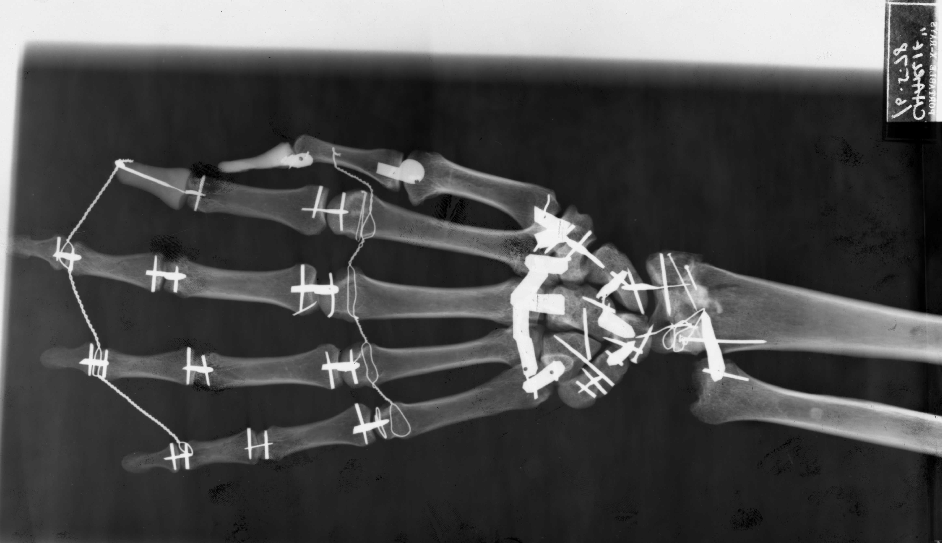
Charles Byrne’s at the of 22 years was still growing
Landolt, 1980, Lancet

Slide 10
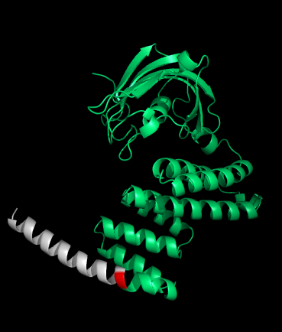
Families from Northern Ireland
gigantism
Three dimensional model of AIP
acromegaly
prolactinoma
AIP mutation
Arg304Stop
carrier
tested, not carrier
carrier status not known
Family B
Family A
Family C
Family D
Stop Codon
Chahal, NEJM, 2011
Notes:
10

Slide 11
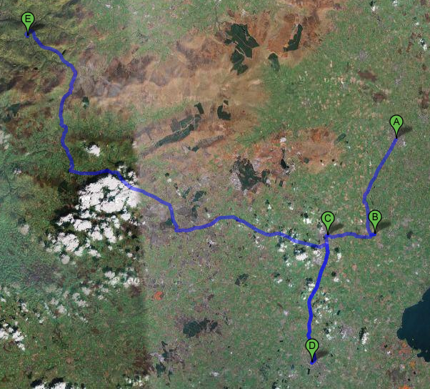
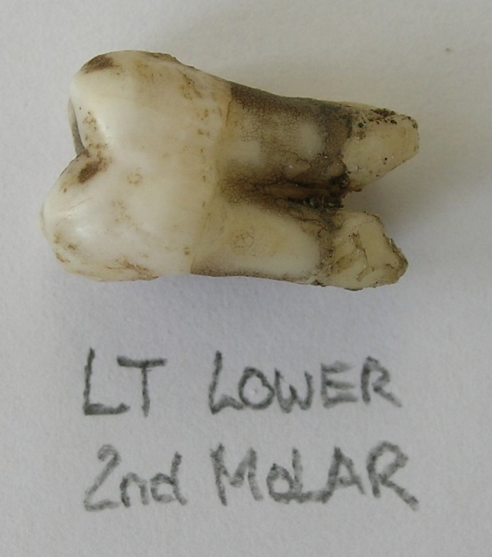
C
5 miles
E
D
A
A – Family A
B – Family B
C – Family C
D – Charles Byrne
E – Knipe brothers
B
Notes:
11

Slide 12
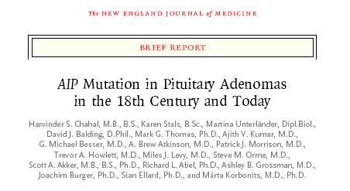
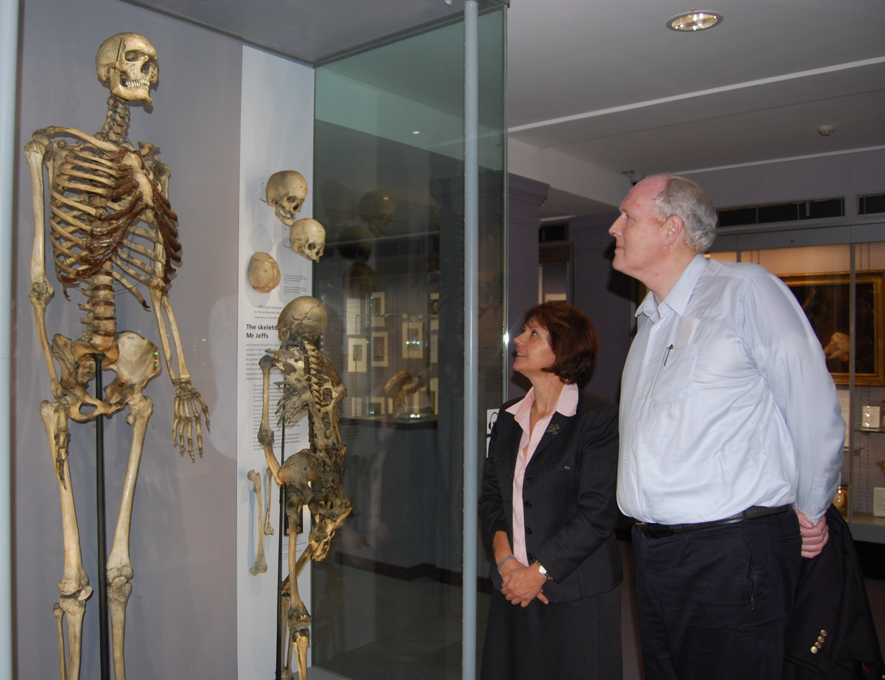
231cm
Died age 22y
208cm
Treated age 19y
Notes:
12
So here I am with our patient we visited the museum and his possible late uncle. I really hope that our work will help to prevent the development of this disease in the future and we can firmly announce gigantism as the disease of the past.

Slide 13
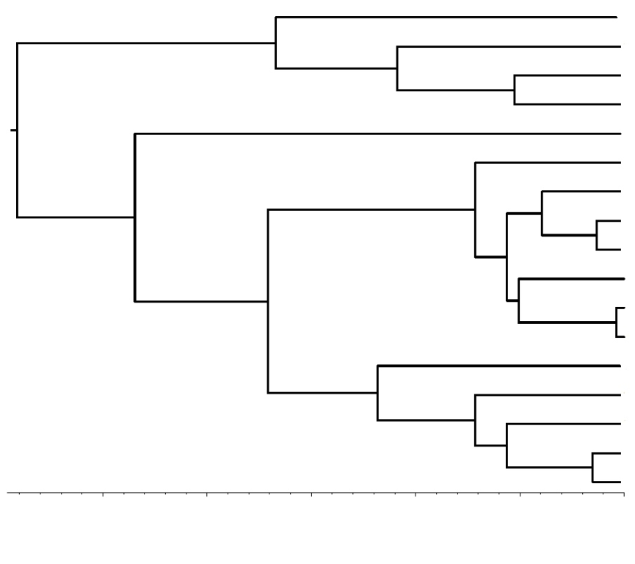
Estimated Age of the Irish Arg304Stop Mutation based on 18 families
1
2
3
4
5
6
7
8
9
10
11
12
13
14
15
16
17
18
Time to most recent ancestor (mutation age)
  102 generations ~ 2550 years
  (95% credible interval 1475-4625m years ago)
10000 simulations
125
100
75
50
25
0
Age (generations)
Notes:
Shown here is one of the best fitting simulated trees, containing the chromosomes as leaves. The tree height is the time to most recent common ancestor (mutation age) and branching points are recombination events.
To estimate the number of carriers living in one generation, we have performed forward simulations of a population based on the estimated mutation age. We obtained an estimated number carriers of 326 per generation (95 CI, 27-1200). This is the equivalent of 978 alive today, assuming that up to three generations overlap at present.
However, this estimate has limited power and should be interpreted with caution.

Slide 14
Why is this research important?
With genetic testing we can find patients early in the course of the disease and can treat them before they grow to be a giant and also before the tumour is too big and difficult to remove.
A simple blood test and science can prevent a lot of problems later.

